Slide 1
Module 2.2 / Week 4
Planning, understanding the entity and evaluating business risk

Slide 2
Learning Objectives
  4.1 Explain why the decision to accept a client is important and describe the primary features of client acceptance and continuance, including the purpose and content of an audit engagement letter.
  4.2 Explain the importance of planning to the audit process.
  4.3 Identify the important aspects of the auditor’s understanding of an entity and its environment.
  4.4 Assess entity business risk.
  4.5. Explain how an auditor develops an overall audit strategy and prepares a detailed audit plan or audit program.
  4.6 Outline the types and uses of analytical procedures and distinguish those that are useful in obtaining an understanding of an entity and assessing business risk.

Slide 3
LO 4.1
Client acceptance and continuance

Slide 4
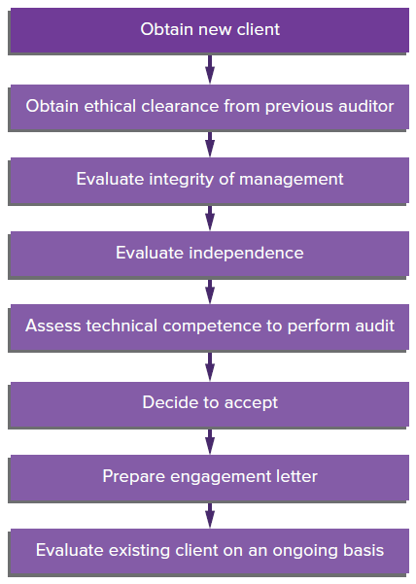
Client Acceptance and Continuance
The auditors need to understand the client relationship starts when considering the acceptance of an engagement and continues throughout the association with the client.
Source: Grant, G. & Simnett, R. (2018). Auditing & Assurance Services In Australia (7th Ed), Sydney, Australia: McGraw Hill

Slide 5
Obtaining clients
The most effective way of obtaining recommendations is to render audit services of a high quality.
Advertising is permitted provided it is not false, misleading or deceptive, or otherwise reflects adversely on the profession.
Competing for prospective clients through tenders is quite common.
Auditors should be careful of audit clients that are opinion shopping.

Slide 6
Quality control policies and client evaluation procedures
APES 320 and ASQC 1 (ISQC1) require an audit firm, as part of its quality control, to establish policies for:
                investigating potential clients and acceptance of an engagement
                periodically reviewing continuance of clients.
Policies and procedures for client acceptance and continuance are important as an audit firm will want to avoid association with a client whose management lacks integrity.

Slide 7
Acceptance and continuance evaluation procedures
Procedures carried out before accepting a new client or continuing with an existing client include:
                obtaining and reviewing available financial information regarding the client
                making inquiries of third parties, such as solicitors and bankers, and communicating with previous auditor
                considering circumstances where the engagement requires special attention or presents unusual risks
                evaluating the firm’s independence and ability to serve the client, including technical skills and knowledge of industry
                ensuring that accepting engagement will not violate the Code of Ethics.

Slide 8
Communication with previous auditor
Communication with the previous auditor helps ensure that the interests of shareholders, the incoming auditor and existing auditor are protected.
It allows the existing auditor to advise prospective auditor of any professional matters they should be aware of before accepting the engagement.
APES 110 requires that:
              the nominated incoming auditor must request the client’s permission to communicate with the previous auditor
              if the client refuses permission, carefully consider whether to accept the engagement
              if permission is granted, the nominated auditor asks the previous auditor in writing for all information necessary to decide whether nomination should be accepted.

Slide 9
Engagement letters
After accepting the appointment, ASA 210.9/ISA 210.9 and APES 305.3.1 require that the auditor and entity agree on terms of engagement to be recorded in an engagement letter
These letters are from the auditor to the client.
They document the arrangements made with the client and clarify matters that may be misunderstood.
They should include:
      the objectives and scope of the audit
      the auditor’s responsibilities
      management’s responsibilities
      identification of the applicable financial reporting framework
      the form and contents of any reports, and a statement indicating that there may be circumstances in the form and content may differ.

Slide 10
Initial Engagement
For the initial audit engagement, ASA 510/ISA 510 requires that the auditor obtains evidence that:
                the opening balances do not contain material misstatements
                the previous period’s closing balances have been correctly brought forward to the current period
                appropriate accounting policies are consistently applied.
Obtaining sufficient appropriate audit evidence about opening balances could be facilitated by reviewing audit working papers of previous auditor.

Slide 11
LO 4.2
Audit planning

Slide 12
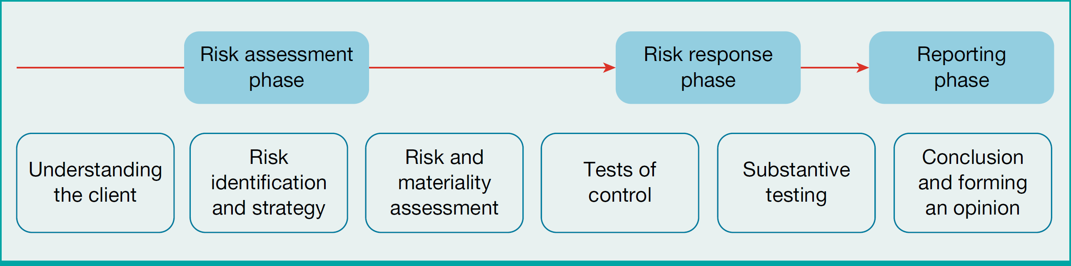
Phases of an Audit
  Risk assessment phase
  Risk response phase
  Reporting phase.
Source: Grant, G. & Simnett, R. (2018). Auditing & Assurance Services In Australia (7th Ed), Sydney, Australia: McGraw Hill

Slide 13
1. Risk assessment phase and Audit Planning (ASA300)
  Auditor must plan the audit to reduce audit risk to an acceptably low level.
  A well planned audit ensures that sufficient appropriate evidence is gathered for accounts most at risk of material misstatement.
Adequate audit planning assists the auditor to:
                devote appropriate attention to important areas of the audit
                identify and resolve potential problems in a timely manner
                organise and manage the audit engagement efficiently and effectively
                select a capable and competent engagement team
                direct and supervise engagement team members and review their work
                coordinate work to be done by auditors of components and experts

Slide 14
  Risk response phase:
  Risk response involves detailed tests of controls and substantive testing of transactions and accounts.
  3. Concluding and reporting on an audit:
  Reporting involves evaluating results of detailed testing in light of the auditor’s understanding of their client and forming an opinion on the truth and fairness of the client’s financial report.

Slide 15
Overall timing of engagement
  The three stages of the audit are planning, interim (before year-end) and final (after year-end).
  Planning: Obtaining an understanding of the entity and its environment, assessing inherent risk, and review of the accounting system.
  Both planning and interim: Study and evaluation of internal control and assessment of control risk.
  Both interim and final: The evidence gathering phase, performing tests of controls and substantive procedures.
  Final: Some substantive tests (e.g. counting inventory) are best done at balance date, others are best done close to engagement completion.

Slide 16
Knowledge of the entity and its environment
ASA/ISA 315.A1 points out that the auditor’s knowledge of the entity can help to:
          assess risk and identify problems
          determine materiality
          consider the appropriateness of accounting policies and disclosures
          identify areas requiring special audit consideration
          develop expectations for use when performing analytical procedures
          design audit procedures in response to assessed risks of material misstatement
          evaluate audit evidence.

Slide 17
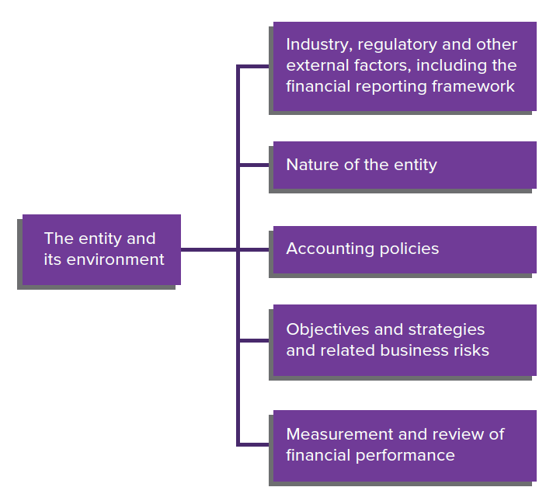
Obtaining an understanding of the entity and its environment
Source: Grant, G. & Simnett, R. (2018). Auditing & Assurance Services In Australia (7th Ed), Sydney, Australia: McGraw Hill

Slide 18
Industry, regulatory and other external factors
          The auditor should have a basic understanding of industry and economic conditions, government regulations, changes in technology and competitive conditions affecting an entity’s operations.
          Knowledge of industry-specific accounting practices is particularly important.
          Sources of information include trade journals, industry statistics and the audit firm’s knowledge management database.

Slide 19
Nature of the entity
The auditor needs to understand the operational structure of an entity.
Operating characteristics include types of products and services, locations, methods of production, distribution and compensation.
In order to understand the business purpose of material transactions, the auditor:
          examines organisational charts and reads manuals
          makes enquiries about policies and procedures in effect
          observes actions of employees and management.

Slide 20
Accounting policies, objectives and measurement techniques
The auditor needs to:
understand the entity’s accounting policies, including the reasons for any changes to them
consider the entity’s objectives and strategies and any related business risks that may result in a risk of material misstatement
gain an insight into the risks facing an entity by examining how management and external stakeholders measure financial performance.

Slide 21
LO 4.4
Business risk

Slide 22
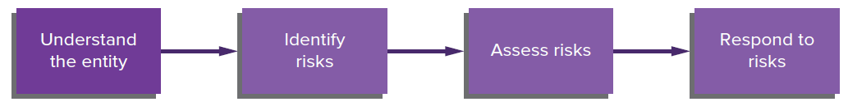
Steps in the risk assessment process
Source: Grant, G. & Simnett, R. (2018). Auditing & Assurance Services In Australia (7th Ed), Sydney, Australia: McGraw Hill

Slide 23
Understanding the entity and its environment
As specified by ASA/ISA 315.11, planning requires the auditor to gain an understanding of the entity and its environment. This knowledge includes:
                industry, regulatory and other external factors
                nature of entity including operations, ownership and governance structure, and entity structure
                Entity’s customers and suppliers
                entity’s selection and application of accounting policies
                objectives, strategies and related business risks.

Slide 24
LO 4.4
Sufficient appropriate
audit evidence

Slide 25
Business risk
Risk that an entity’s business objectives will not be attained as a result of external and internal factors, pressures and forces brought to bear on an entity and, ultimately, the risk associated with the entity’s profitability and survival.
To assess whether the financial report is fairly presented, auditor must undertake risk-assessment procedures to understand the entity’s business strategy and risks and its ability to respond to changing environmental conditions.

Slide 26
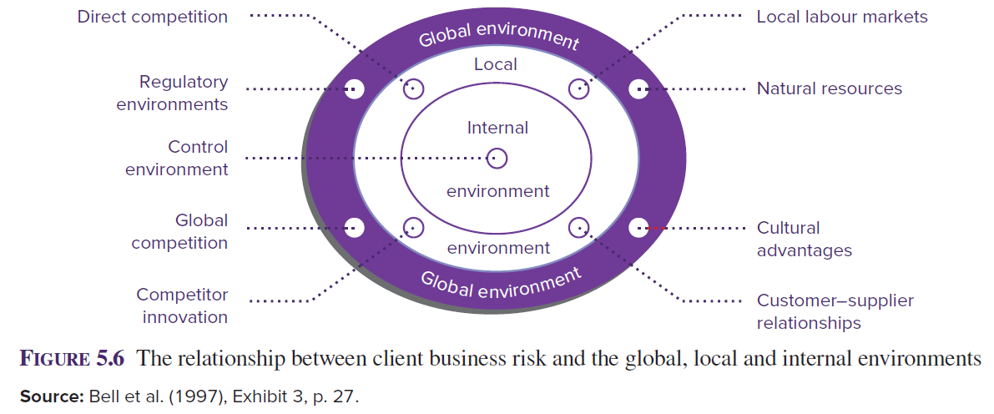
Relationship between client business risk and global, local and internal environments
Source: Grant, G. & Simnett, R. (2018). Auditing & Assurance Services In Australia (7th Ed), Sydney, Australia: McGraw Hill

Slide 27
Reliability of audit evidence
Reliability of audit evidence is influenced by nature and source:
    Evidence from sources outside an entity is more reliable than evidence obtained solely from within the entity.
    Evidence generated internally is more reliable when the internal control structures are effective.
    Evidence obtained directly by the auditor is more reliable than evidence obtained from the client.
    Evidence in the form of documents or written representations is more reliable than oral representations.
    Evidence provided by original documents is more reliable than evidence provided by photocopies or facsimiles (ASA 500.A31/ISA 500.A31).

Slide 28
Risk-Assessment Procedures
ASA/ISA 315.A5-A16 identify a number of methods of obtaining knowledge of the entity including:
        considering previous experience with entity and industry
        discussion with senior people and internal auditors in the entity
        discussion with other auditors and advisers and knowledgeable people, such as industry economists and industry regulators
        review of significant legislation and regulations
        reading of industry publications and documents produced by entity
        visiting entity’s premises
        performance of analytical procedures.

Slide 29
Assessing Business Risk
The auditor uses entity and industry information to identify business risks that may affect the audit.
The assessment of client business risk is an input into the auditor’s assessment of the risk of material misstatement in the financial report.
According to ASA/ISA 315.10, the members of the audit engagement team should discuss the susceptibility of the entity’s financial report to material misstatement.

Slide 30
Business risks and risks of material misstatement
Most business risks eventually have financial consequences and therefore eventually affect the financial report.
However, not all business risks result in risks of material misstatement.
Thus, business risk is broader than the risk of material misstatement but includes it.

Slide 31
Techniques for assessing business risk
To obtain information about the risks arising due to the nature of the entity and its environment, auditors may use strategic management techniques such as:
  Strengths Weaknesses Opportunities Threats (SWOT) analysis
  Political Economic Social, Technological (PEST) risk analysis
  value-chain analysis
  non-financial performance measurement.

Slide 32
Significant risks
Auditor is required to determine whether any identified risk is a ‘significant risk’, being a risk of material misstatement that requires special audit consideration.
Factors to consider when determining significant risks include:
                the risk of fraud
                relationship to recent significant economic, accounting or other developments
                complexity of the transactions
                significant transactions with related parties
                degree of subjectivity in measuring financial information
                whether significant transactions are unusual or outside the normal course of business for the entity.

Slide 33
Auditor response to assessed risks
An auditor should determine overall responses to assessed risks at the financial report level.
  Responses at the financial report level include:
                emphasising need to maintain professional scepticism
                assigning more experienced staff
                using experts
                providing more supervision
                incorporating unpredictability into selection
                of further audit procedures.

Slide 34
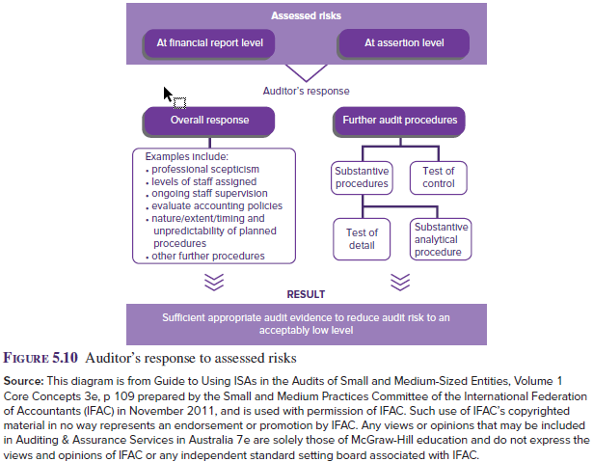
Assessing risks at the assertion level
At the assertion level, ASA 330.6 (ISA 330.6) requires that the auditor’s assessment of identified risks provides a basis for designing and performing further audit procedures
Source: Grant, G. & Simnett, R. (2018). Auditing & Assurance Services In Australia (7th Ed), Sydney, Australia: McGraw Hill

Slide 35
LO 4.5
Developing an overall audit strategy

Slide 36
Developing an overall audit strategy
The auditor obtains an understanding of the client’s entity, its environment and its business risks, and through that understanding makes judgments in relation to areas of audit risk and materiality to assist in developing an overall audit strategy and audit plan.
Interrelationship between materiality, audit risk and what constitutes sufficient appropriate audit evidence impacts on auditor’s strategy.
Audit strategies can range from a lower assessed level of control risk approach to a predominantly substantive approach.

Slide 37
Range of Audit Strategies
Lower assessed
level of
control risk
Predominantly
substantive
approach
Audit strategy may be anywhere along this continuum.
Source: Grant, G. & Simnett, R. (2018). Auditing & Assurance Services In Australia (7th Ed), Sydney, Australia: McGraw Hill

Slide 38
Lower assessed level of control risk approach
If internal control is well designed and expected to be highly effective, audit strategy will include:
          low or medium assessed level of control risks
          extensive understanding of relevant parts of internal control
          extensive tests of control
          reduced level of substantive audit procedures, based on planned acceptable level of detection risk being high or medium.

Slide 39
Predominantly substantive approach
If the auditor believes adequate controls do not exist or might be ineffective, or that testing controls are not cost effective, the audit strategy will be to:
                use a planned assessed level of control risk of high
                plan to obtain a minimum understanding of internal control
                plan no tests of control
                plan extensive substantive audit procedures based on planned acceptable level of detection risk of low or medium.

Slide 40
Preparing detailed audit plan or program
ASA 300/ISA 300 requires the auditor to develop and document an audit plan/program.
An audit plan or audit program is a detailed list of audit procedures that need to be applied to a particular balance or class of transactions
to implement the audit strategy.
ASA 300.A19/ISA 300.A19 notes that auditor may document audit plan by use of appropriately tailored (for client) standard audit programs and checklists.

Slide 41
Purpose of detailed audit plan/program
An audit program will outline the following characteristics of audit procedures:
                Nature — particular audit procedures to use and
                particular items to which a procedure will be applied.
                Extent — number of items to which procedures will be applied and number of different tests to be performed.
                Timing — appropriate time to perform the procedure.

Slide 42
LO 4.6
Analytical procedures

Slide 43
Analytical procedures at planning stage
Analytical procedures involve the use of ratios, trend analysis and operating statistics for comparison with internal and external data.
Can be used at all stages of the audit: e.g. in planning stage, as a form of evidence or as part of a final review.
Analytical procedures at planning stage aallows the auditor to understand the business and identify areas of potential risk, thereby assisting in the determination of the nature, timing and extent of audit procedures.

Slide 44
Types of analytical procedures
Simple procedures:
simple comparisons
ratio analysis
common-size statements
trend statements
time series analysis
More complex procedures:
time series modelling
regression analysis
financial modelling

Slide 45
Analytical procedures most commonly used in planning
Comparison of current balances in the financial report with balances of previous periods and budgeted amounts (simple comparisons).
Computation of ratios and percentage relationships for comparison with previous years, budgets and industry averages (ratio analysis).
Significant variations from expectations indicate areas requiring investigation.

Slide 46
Ratio analysis
At the planning stage the auditor is undertaking ratio analysis on unaudited financial information, thus any ratios not in accordance with the auditor’s expectations will indicate areas requiring significant audit attention.
These ratios may be compared to:
          industry data:
                average ratios in industries listed on the ASX
          internal data:
                previous years
                budgets or forecasts
                segment or division data.

Slide 47
Ratios commonly used at the planning stage
Short-term liquidity:
  current ratio (current assets to current liabilities)
  quick asset ratio (liquid assets to current liabilities)
  operating cash flow ratio (cash flow from operations to current liabilities).
2. Activity:
  receivables turnover (net sales to average accounts receivable)/days in receivables (365 days to receivables turnover)
  inventory turnover (cost of goods sold to average inventory) /days in inventory (365 days to inventory turnover).

Slide 48
Ratios commonly used at the planning stage
3. Profitability:
  gross profit and net profit ratio (gross profit or net
  profit to net sales)
  return on total assets (net profit before interest and taxes to total assets)
  return on shareholders’ equity (net profit to ordinary shareholders’ equity).
4. Solvency:
  debt to equity ratio (total liabilities to shareholders’ equity)
  times interest earned (net profit before interest and taxes to annual interest expense).

Slide 49
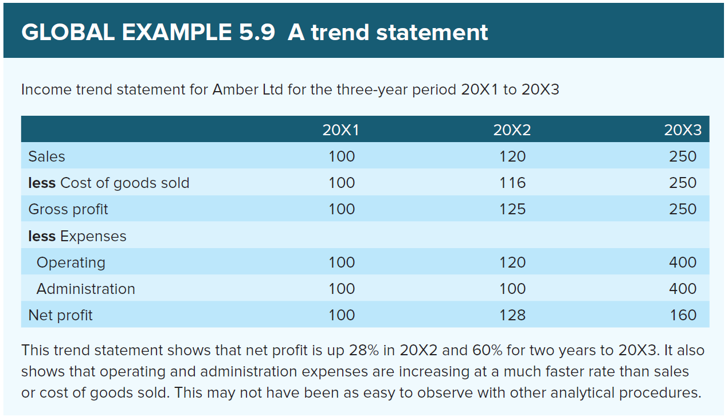
Trend Statements
Each item is expressed as a percentage of its own level from a base year, thus allowing focus on trend rather than absolute magnitude of dollar change.
Source: Grant, G. & Simnett, R. (2018). Auditing & Assurance Services In Australia (7th Ed), Sydney, Australia: McGraw Hill

Slide 50
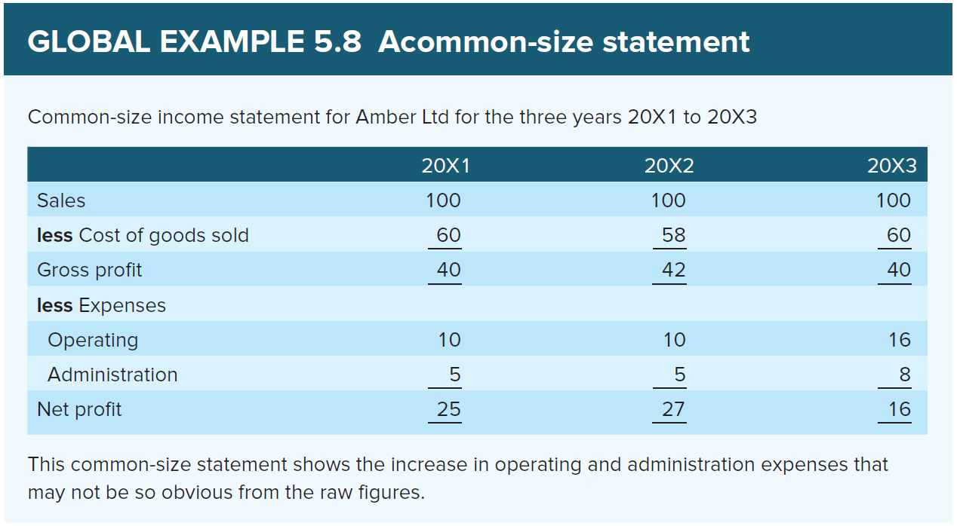
Common-size Statements
Express balance sheet components as a percentage of total assets and income statement components as a percentage of total revenue.
Source: Grant, G. & Simnett, R. (2018). Auditing & Assurance Services In Australia (7th Ed), Sydney, Australia: McGraw Hill

Slide 51
Data used in analytical procedures
Auditor must consider whether data needed are easily available and their reliability.
For reliability:
          Data from an independent source outside the entity are generally more reliable than internal data.
          Data from a system with effective internal controls are more reliable than data from a poorly controlled system.
          Data audited in the previous year or in the current audit are more reliable than unaudited data.
          Data from a variety of sources that corroborate each other are more reliable than data from only one source.
          Data from the department within the entity that is responsible for the amount being audited are generally less reliable than data from another department.

Slide 52
Plausibility, predictability and precision of analytical relationships
  Relationships in a stable environment are more predictable than relationships in a changing environment.
  Direct relationships are more predictable than indirect relationships.
  Disaggregated relationships show clearer relationships than combined or aggregated relationships.
  Relationships involving income statement amounts tend to be more predictable than relationships involving only balance sheet accounts (amounts at a point in time).
  Relationships involving transactions subject to management discretion are less predictable than those not subject to such discretion.

Slide 53
References
Grant, G. & Simnett, R. (2017). Auditing & Assurance Services In Australia (rev: 6th Ed), Sydney, Australia: McGraw Hill
Moroney, R., Campbell, F., & Hamilton, J., (2017). Auditing: A Practical Approach, (3rd ed), Sydney, Australia: Wiley

